Slide 1

Full-Stack Web Development Using JAVA

Slide 2
Today's Agenda
Java Platforms
What is Web Development ?
What is Front End ?
What is Back End ?
What is Full Stack Web Development ?
Role Of Java In Web Development

Slide 3
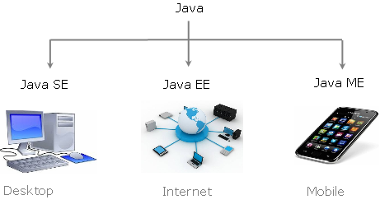
Java Platforms

Slide 4


What Is JEE ?
JEE used to stand for Java Enterprise Edition but now it has been renamed to Jakarta Enterprise Edition
.
It is a Java based platform used for developing secure and scalable enterprise/web applications.

Slide 5
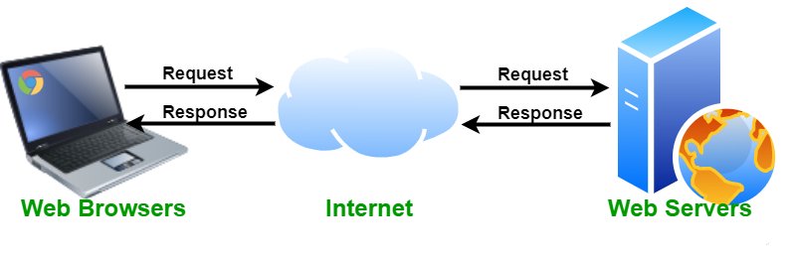
What Is A Web Application?
A Web application (Web app) is a program that is stored on a server and delivered over the Internet through a browser interface.

Slide 6
Components Of A Web Application
Every web application , primarily contains 3 very important components and these are called :
Front End
Back End
Database

Slide 7
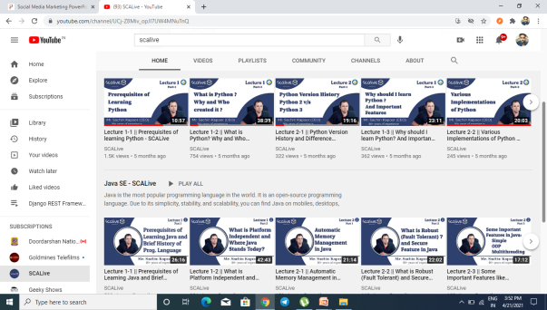
What Is Front End ?
It includes everything the user experiences directly: from text and colors to buttons, images etc.
The front end , also called client side of a web application.
The main purpose of the client side is to collect data from users.
is everything that the user sees and interacts within inside their browser.

Slide 8
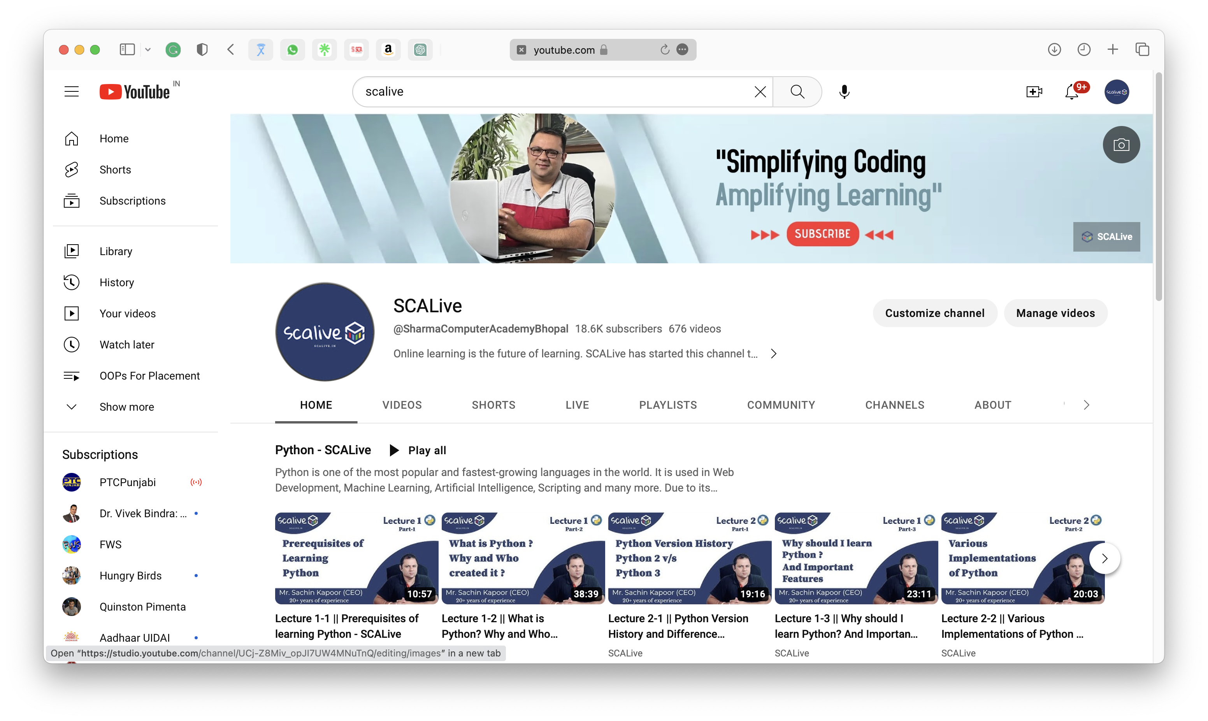
Example Of Front End

Slide 9




What Is Front End Made Up Of ?
The front end is built with 3 key technologies :
HTML
JavaScript
CSS

Slide 10
The Three Key Players In Front End
Role Of HTML , CSS & JS:
HTML (HyperText Markup Language):
It is the backbone of the Web. Every website you visit is built with HTML. It takes care of
all the structure and content
CSS (Cascading Style Sheets):
It is what controls the look and feel of the page. CSS sets the colors, fonts, Background
and the way is page laid out
JavaScript:
It is a programming language commonly
used to create interactive effects within web browsers.

Slide 11
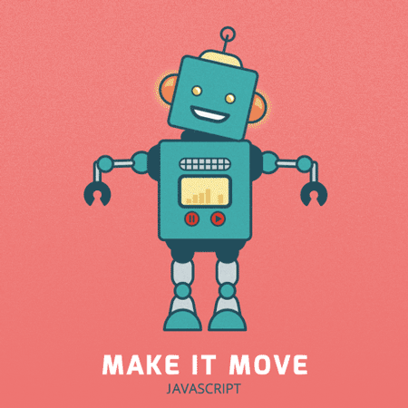
The Three Key Players In Front End

Slide 12
What Is Back End ?
Back-end development refers to the server-side development.
It is the term used for the behind-the-scenes activities that happen
when performing any action on a web application.
Backend developer focuses on databases, business logic, and the architecture of web application.

Slide 13
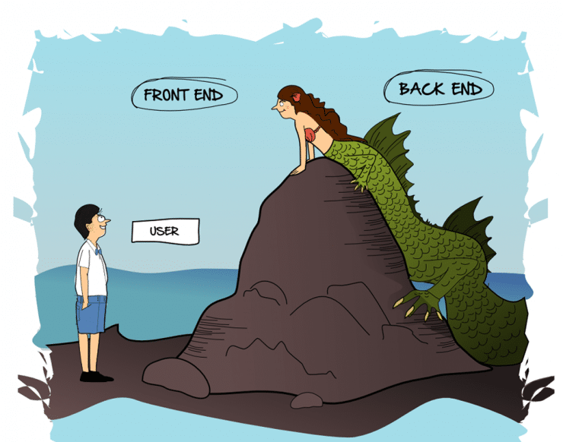
Front End V/S Back End

Slide 14
What is Back End Made Up Of ?
A backend developer needs to understand 2 very important elements :
1
A server side programming language/technology like Python , Java, PHP , Ruby, C# , Node JS etc
And
Database Management System like Oracle, MySQL, MongoDB etc.
2

Slide 15
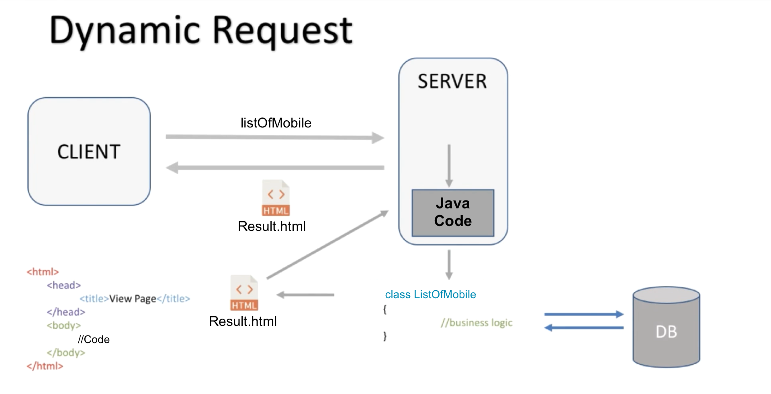
Role Of Java In A Web Application

Slide 16
What Full Stack Web Development Contains ?
Full stack developers work with both , the front and the back end of a web application.
They’re familiar with HTML, CSS, JavaScript and a back end language which can be Java or Python or Node JS

Slide 17
What We Will Learn ?
The Full Stack Web Development course contains all the technologies required to become a complete web developer
That means , we will be covering everything needed to develop a COMPLETE MODERN WEB APPLICATION :
HTML
CSS
JavaScript
Modern Java Script ( The ES Series)
AJAX / API Calling
JSON
JDBC
Servlets
JSP
MVC Pattern
Session Management
Java Beans
Parallelly , CORE JAVA will also be covered in your respective batches

Slide 18
Thanks!
Do You have any question ?
07314853128 || 07554274659
Please keep this slide for attribution

